Slide 1
CAR Champion Calibration Meeting CAR Review
Team “B”
Tovia Bat-Leah (CAR 143913123 Finding)
Jeff Lietz (CAR 143912892 Finding)
Kathy Lindstrom (CAR 143913435 Observation)
Jeff Lietz (CAR 143913094 Exemplary)

Slide 2
CAR 143912892 Finding
Presented by Jeff Lietz

Slide 3
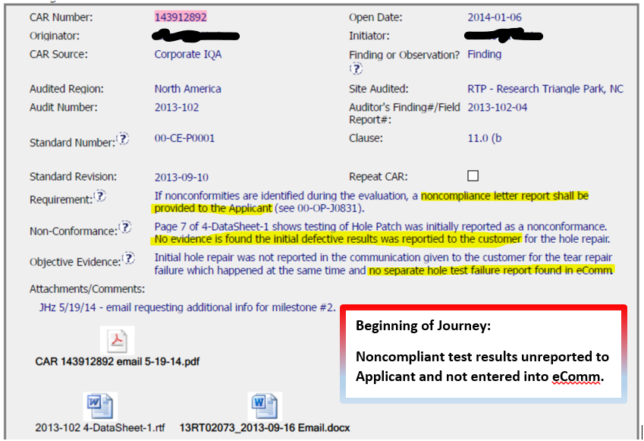

Slide 4
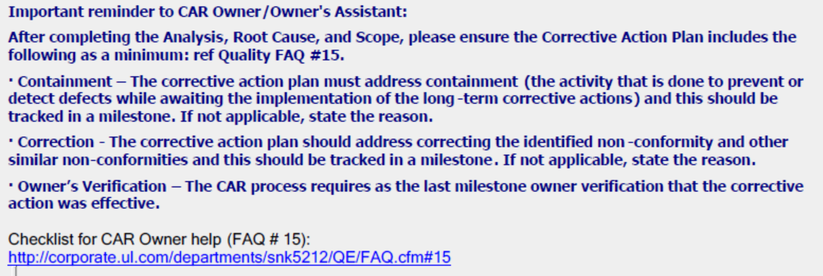
Excellent Reference to Helpful Resources…..
“…you can lead a horse to water…”

Slide 5
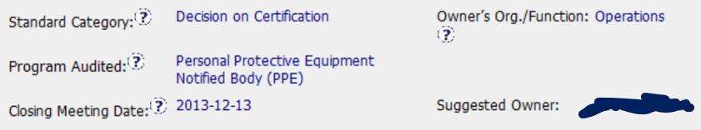
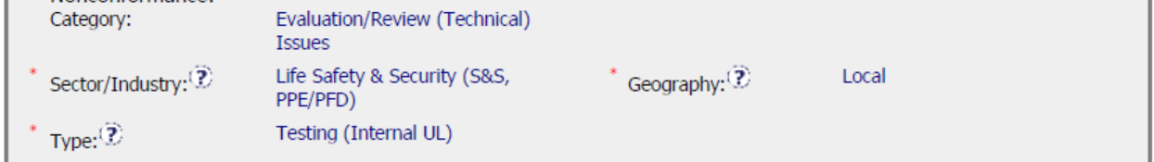
Applicable Selections….

Slide 6
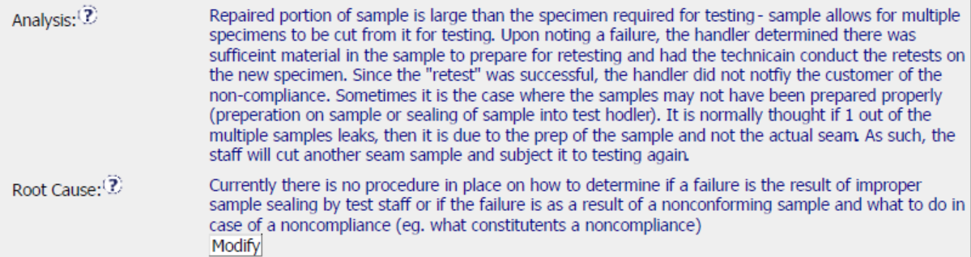

The journey takes a few unexpected turns…..

Slide 7
Misalignment: CA = Analysis + RC?
The following has been paraphrased for discussion purposes:
Analysis:
Current practice rules out handler error by re-testing failed material if sufficient material exists.
Root Cause:
Procedures do not instruct the individual on how to determine if a noncompliance is the result of improper material preparation or nonconforming material. It further states that instructions are not provided on what to do in the event of a nonconforming test.
Corrective Action:
Develop a procedure showing what to do in the event of a nonconforming test.
Thoughts:
Analysis appears to be under developed. (5-Whys not exhausted)
RC is abstract. Can you know for certain if failed results were from human error? Action required for Non-Conforming test is covered in SOP. Clarification?
CA does not provide means of assisting technician with determining the type of nonconformance (Human Error vs Nonconforming Material)
Other?

Slide 8
Keep your eye on the ball….
Original NC:
Noncompliant test results unreported to Applicant and not entered into eComm.
Analysis:
Retests performed to rule out Handler error.
Root Cause:
Can’t determine if test failure resulted from Human Error or Materials and don’t know what to do with NC.
Corrective Action:
Show me what to do with an NC

Slide 9
CAR Overview

Slide 10
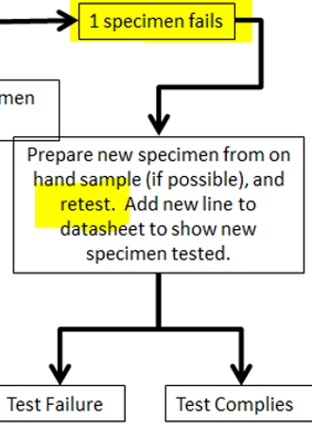
Verified Effective?
SOP 03-LO-W0037 references ASTM F903-2010 which states that if a sample fails, the test must be terminated. It appears our revision conflicts with the requirement outlined in the ASTM Standard. (See Below)
03-LO-W0037:
ASTM F 903-2010:
9.9 Observe the specimen. The specimen fails if a droplet of liquid appears or a characteristic discoloration (see 9.2) indicating the presence of the chemical appears on the viewing side of the specimen, or both. If this occurs, record the failure, and terminate the test.

Slide 11
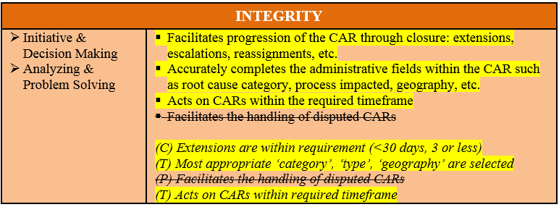
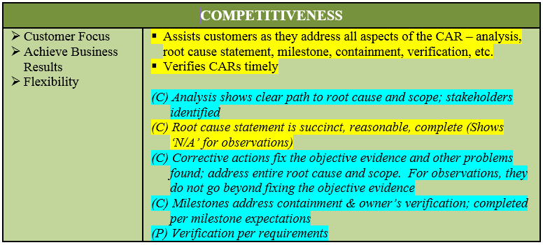
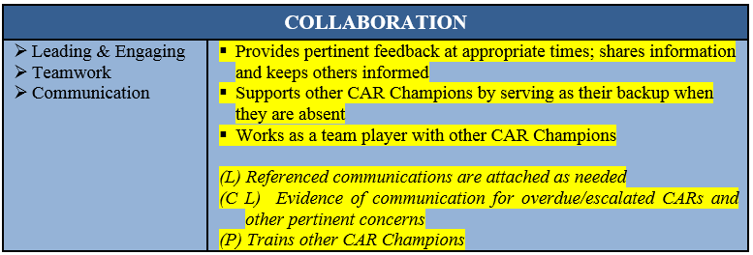
CBS Score Card
Analysis/RC/CA Misalignment
Effectiveness Questionable

Slide 12
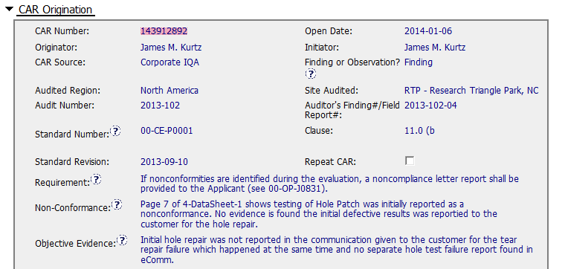
The issue is that UL didn’t inform the test failure to the customer. However, The analysis says that there is no need to inform the incident as the test was OK by having second try with same material.

Slide 13
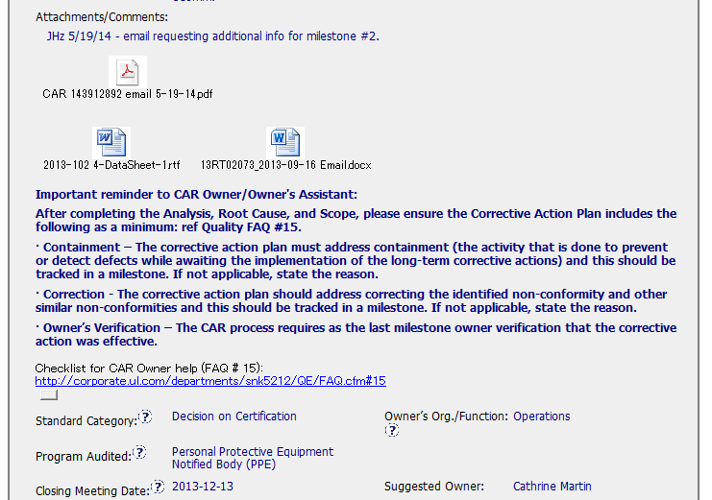

Slide 14
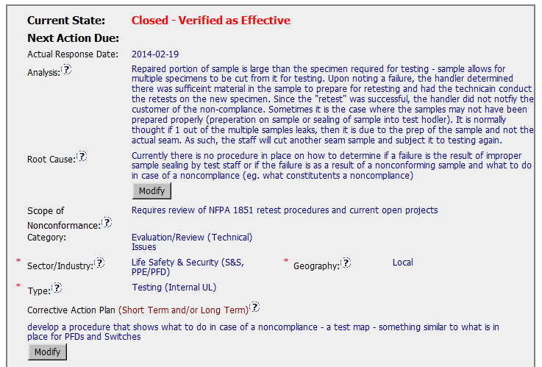
There is no SOP or standard specified.
There is no staked holders identified.
The scope is not a true scope
It seems that same test conducted and the result was “Pass”. So, the handler proceed the project without notifying to the customer. Is this really finding???
Root cause is too long.
(T) Most appropriate ‘category’, ‘type’, ‘geography’ are selected – OK
(C) Analysis shows clear path to root cause and scope; stakeholders identified – No
(C) Root cause statement is succinct, reasonable, complete (Shows ‘N/A’ for observations) – No

Slide 15
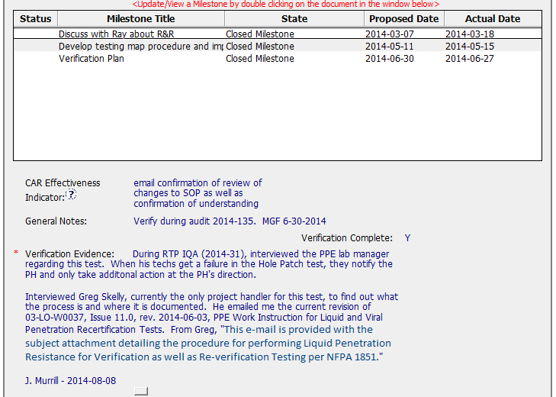
Containment was not conducted.
(C) Corrective actions fix the objective evidence and other problems found; address entire root cause and scope. - There may be better way to resolve this CAR.
(C) Milestones address containment & owner’s verification – No

Slide 16
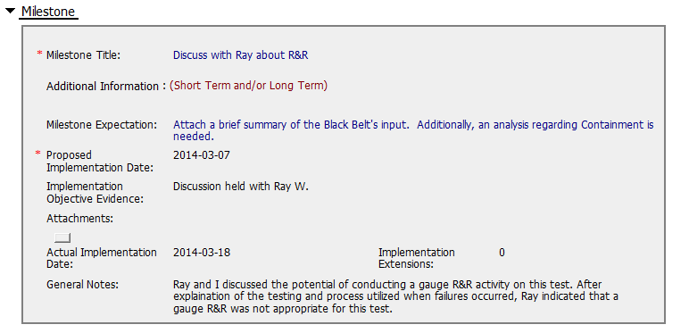
This should have been considered in analysis stage.
(C) Milestones completed per milestone expectations – Not really.

Slide 17
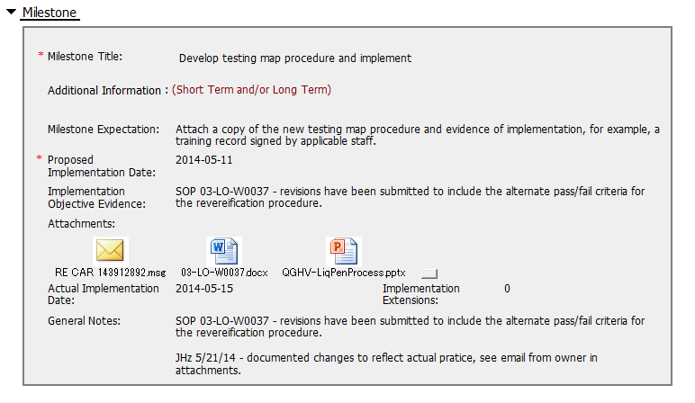
Although it says revision has been submitted, the issued date of the SOP is before the finding.
The SOP was not published before the milestone was accepted or before the CAR was closed.
(C) Milestones completed per milestone expectations – questioning

Slide 18
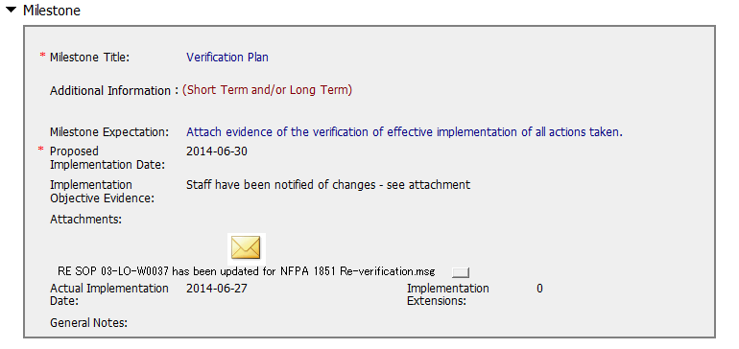
This is just communication by email. It seems not to be verification for this finding.
(C) Milestones completed per milestone expectations – questioning

Slide 19
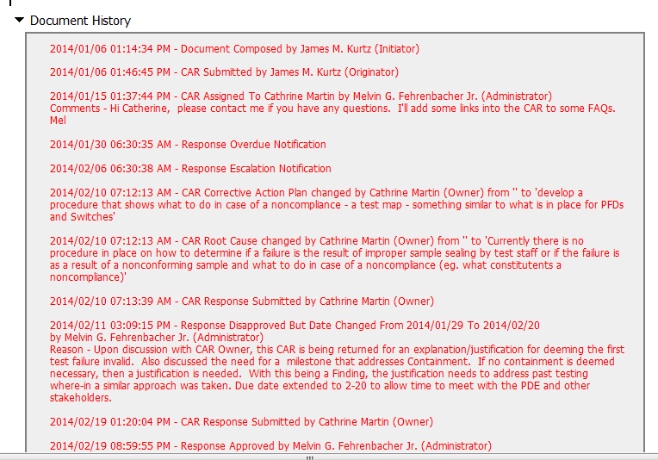
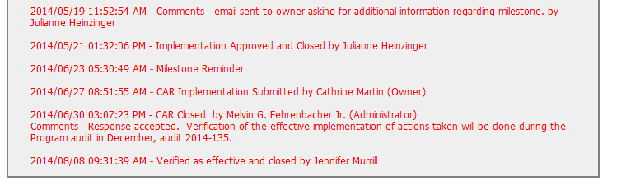
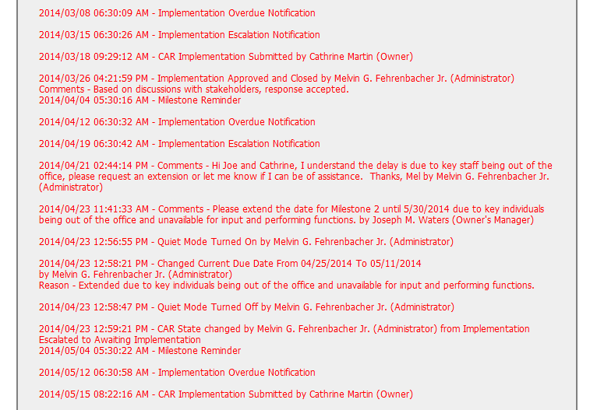
(T) Acts on CARs within required timeframe – No
(C) No Extensions, No overdue, No escalated, No disputed – No

Slide 20
CAR 143912892 – CBS Check
CBS Requirements | Excellent | Moderate | Need Improve | N/A
(C) Extensions are within requirement (<30 days, 3 or less) |  |  | X
(T) Most appropriate ‘category’, ‘type’, ‘geography’ are selected | X
(P) Facilitates the handling of disputed CARs |  |  |  | X
(T) Acts on CARs within required timeframe |  |  | X
(C) Analysis shows clear path to root cause and scope; stakeholders identified |  |  | X
(C) Root cause statement is succinct, reasonable, complete (Shows ‘N/A’ for observations) |  | X
(C) Corrective actions fix the objective evidence and other problems found; address entire root cause and scope. For observations, they do not go beyond fixing the objective evidence |  |  | X
(C) Milestones address containment & owner’s verification; completed per milestone expectations |  |  | X
(P) Verification per requirements |  |  | X
(L) Referenced communications are attached as needed |  | X
(C L) Evidence of communication for overdue/escalated CARs and other pertinent concerns |  |  | X
(P) Trains other CAR Champions |  |  |  | X

